Slide 1
Clothing Shop Inventory management System Using Spring Boot
Presented By-
Vaishnavi Chavan (EBEON1222703303)(Team Leader)
Members=
Madhura Jadhav
Apeksha Babar
Prachi Salunkhe
Rutuja Nalawade
Guided by-
Varadharajan A

Slide 2
Clothing Shop Inventory management System
Listout the entire modules
1. Home page module
2. Admin process
3. Login Page
4 . Shop All- Order details
Add Cart
Payment Processing
5. Storage- Stock maintenance
Delivery system
6. Ratings , Feedback

Slide 3
What is inventory Management? Inventory management, a critical element of the supply chain, is the tracking of inventory from manufacturers to warehouses and from these facilities to a point of sale. The goal of inventory management is to have the right products in the right place at the right time.
Goal of my module(s)
Include planning, organizing, directing, supervising, controlling, and implementing policies related to the company's operationalization. home page (or homepage) is the main web page of a website. The term may also refer to the start page shown in a web browser when the application first opens. Usually, the home page is located at the root of the website's domain or subdomain. For example, if the domain is example.com, the home page is likely located at Function A home page is the primary web page that a visitor will view when they navigate to a website via a search engine, and it may also function as a landing page to attract visitors.

Slide 4
Home Page Module
1. A clear value proposition
Tell your visitors exactly what you do with a clear, easy-to-find value proposition.
2. Intuitive navigation
Your navigation should be easy to understand and use for even a first-time visitor to find what they need.
3. A clear call-to-action
When someone arrives on your homepage — or any page on your website — it should be clear what action you want them to take next.
4. Highlights of your content
Since your content is the heart of any inbound marketing strategy, encourage people to view and subscribe to your content by highlighting it on your homepage.

Slide 5
Login Page module
Basically ,for any software security is a major concern, So we have developed a secure application. Without being authenticated no user is allowed to view any other interfaces. For the login page, we have a User ID ,Password ,Profile. After being authenticated is authorized to perform certain work according to his/her profile.

Slide 6
Admin Module
Primarily , the user who will interact with the system will be the administrator of the institution assigned to take care of all data transactions and insertion or update.
* Sales details
* Order details
* Payment details
* User Details
* Settings

Slide 7
Architecture diagram
Add details
Admin
Sales details
Login
Dashboard
Stock maintenance
Brand
Order
Payment

Slide 8
Tech architecture(Full Stack Concept)
Spring-core,MVC
JSON binding
Embeded Srvelet container-Tomcat
HTML
CSS
Javascript
SpringBoot
Browser
Frontend
Backend
DB Viewer
SpringBoot
MySql

Slide 9
Dataflow Diagram
First open browser enter local host
Home page
In this home page about, contact us page is there
Login page
Enter Username , password
Open Admin module
Add details show sales details

Slide 10
Shop All Module
1.OTP Verification Module:
The OTP feature prevents some forms of identity theft by making sure that a captured username/password pair cannot be used a second time. Typically the user's login name stays the same, and the one-time password changes with each login.
2.Supplier Management
The purpose of Supplier Management is to plan, manage and review suppliers of IT-services and infrastructure and to monitor the agreed service levels. This objective should be fulfilled by balancing the quality of services against the economic cost.

Slide 11
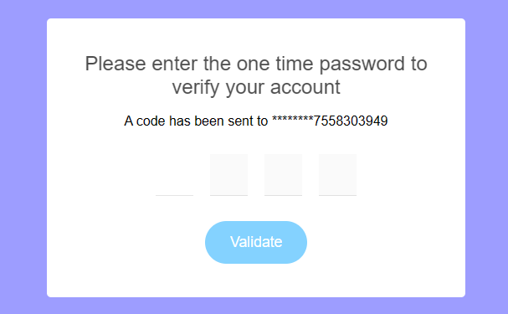
GUI

Slide 12
Challenging issues
Project Using Spring Boot is difficult task .But I did it.
Thyemleaf dependency are used

Slide 13
Conclusion
Inventory management is a very complex but essential part of the supply chain. An effective inventory management system helps to reduce stock-related costs such as warehousing, carrying, and ordering costs. This project helps us to access and manage the information easily.

